Slide 1

Predicting Disposable Income and Savings Using Machine Learning
This project explores the use of machine learning models to predict disposable income and potential savings based on personal finance factors.
By Sehba Khan

Slide 2

Project Introduction
1
Problem
2
Objective
Many individuals lack insights into their financial resources.
Empower users with predictive insights for informed financial decisions.
3
Significance
Improved financial literacy contributes to greater economic well-being.

Slide 3

Problem Statement
Financial Literacy Gap
Impact
Individuals struggle to analyze income and spending habits, leading to poor financial management.
Financial literacy directly impacts quality of life; predicting disposable income can guide budgeting.
Statistics
A significant percentage of individuals lack awareness of their spending habits, contributing to debt accumulation.

Slide 4
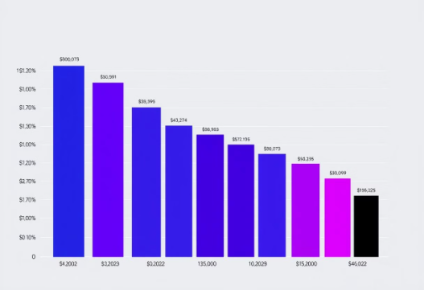
Data Collection
Data Source
Dataset Details
Data Distribution
The dataset was sourced from Kaggle, focusing on Indian personal finance and spending habits.
The dataset comprises \[number of records, e.g., 10,000 records and 10 features], providing a rich foundation for analysis.

Slide 5
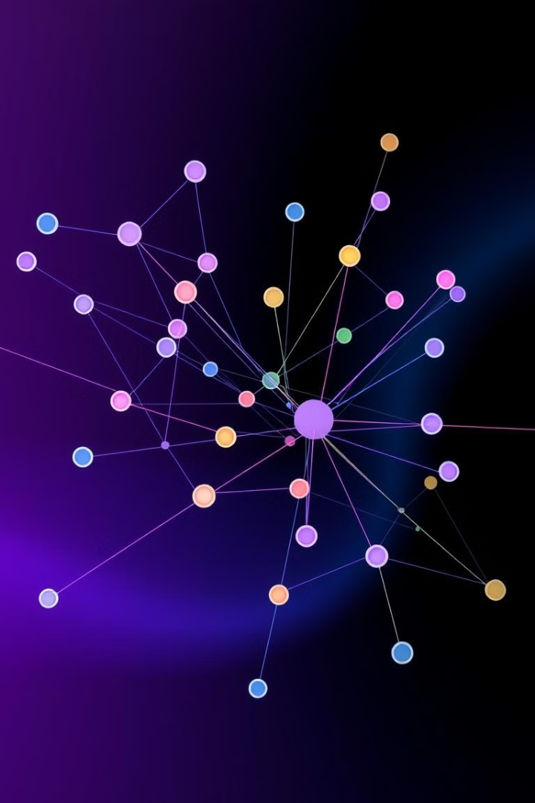
Data Exploration
Feature Type
Examples
Continuous
Income, Spending Categories
Categorical
Occupation, City Tier

Slide 6
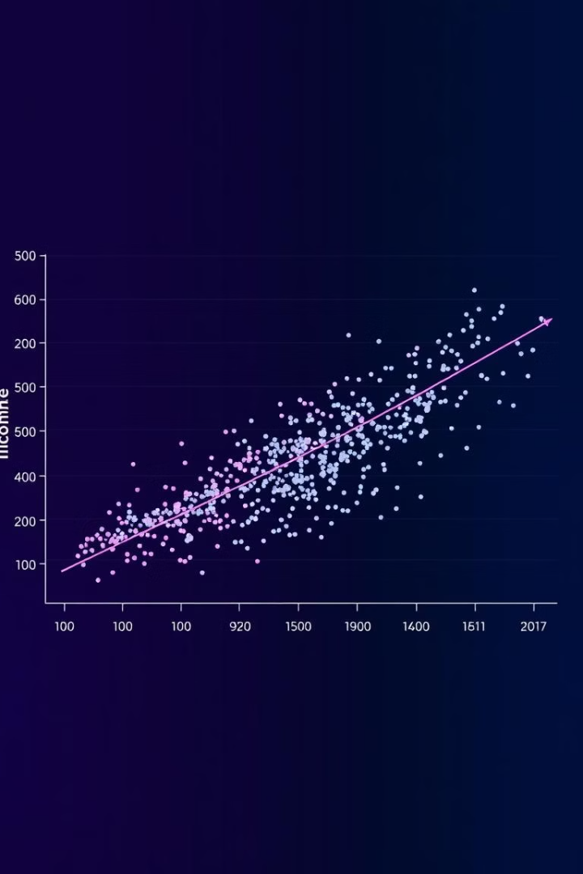



Exploratory Data Analysis (EDA)
Income and Disposable Income
Examined relationships between income and disposable income.
Occupation, City Tier and Disposable Income
Identified trends in disposable income across different Occupations, City Tiers.
Spending Trends
Analyzed spending trends based on various spending categories and identified patterns and fluctuations in consumer behavior.

Slide 7
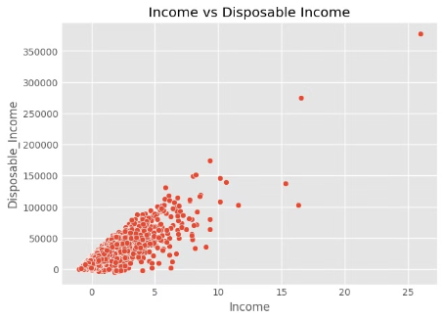
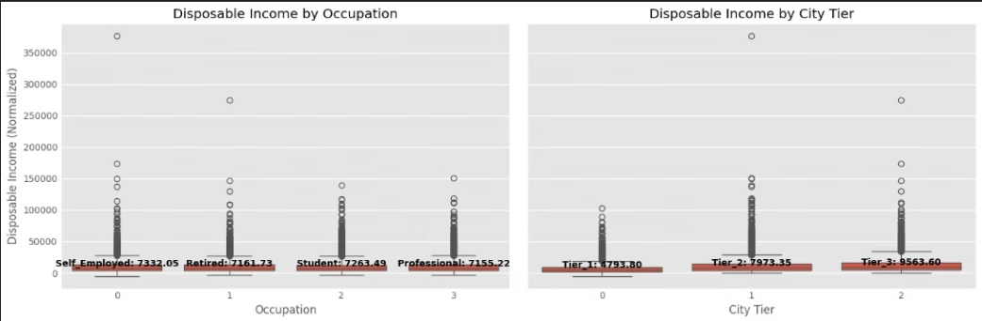
Exploratory Data Analysis (EDA):
Income and Disposable Income
Disposable Income by Occupation and City Tier
Visualize relationships between income and disposable income.
Analyze the distribution of disposable income among different occupations and city tiers to identify any potential patterns or differences.

Slide 8
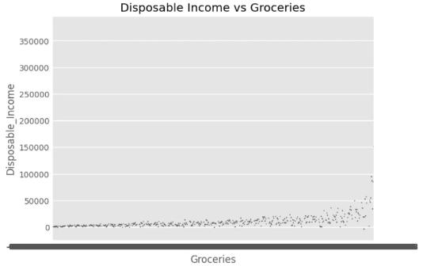
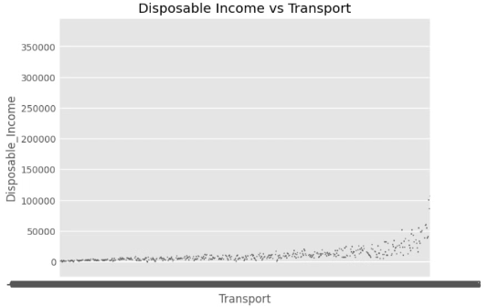
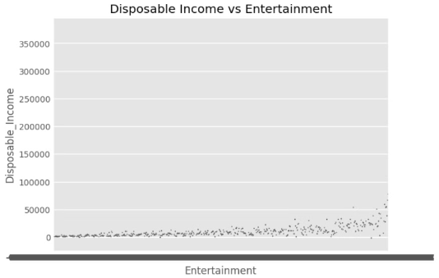
Spending Trends by Spending Categories:
Disposable income and Groceries
Graph between disposable income and Transport
Graph between disposable income and Entertainment
Examine the correlation between disposable income and spending on groceries to gain insights into consumer behavior and how it relates to income levels.
Analyze the correlation between disposable income and entertainment to gain insights into how income levels influence recreational activities and entertainment preferences.
Investigate the relationship between disposable income and transportation to understand the impact of income levels on commuting habits and transportation preferences.

Slide 9

Data Preprocessing
Data Cleaning
1
Converted financial columns to numeric and handled missing values using mean imputation.
2
Feature Scaling
Normalized continuous features using StandardScaler to improve model performance.
Encoding
3
Categorical features were encoded using one-hot encoding.

Slide 10
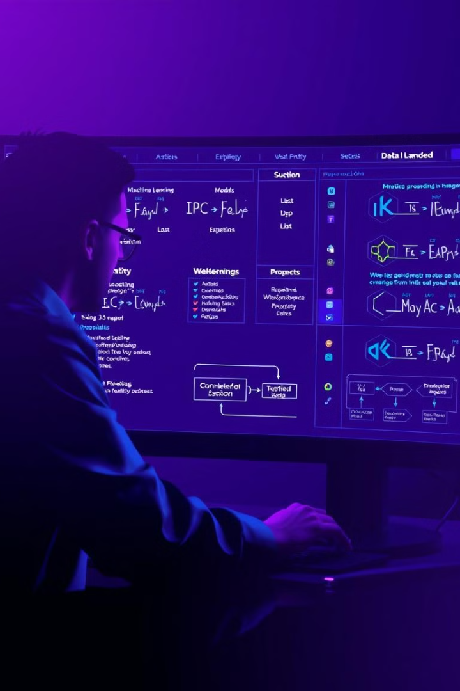
Model Selection
1
Models Considered
2
Model Selection Rationale
Linear Regression and Random Forest Regressor were evaluated.
Random Forest was chosen for its robustness and ability to handle non-linear relationships.
3
Model Advantages
Random Forest excels in feature importance analysis, providing valuable insights.

Slide 11
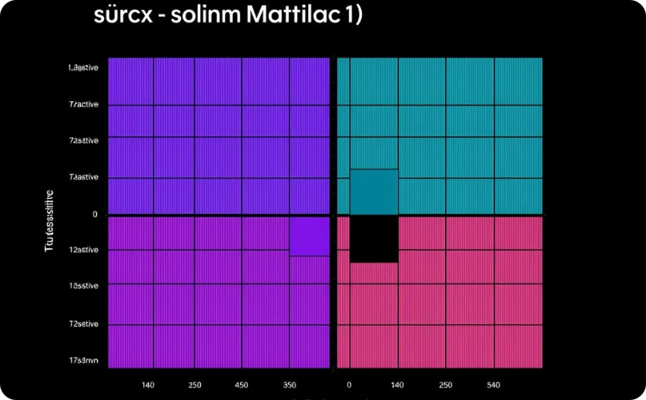
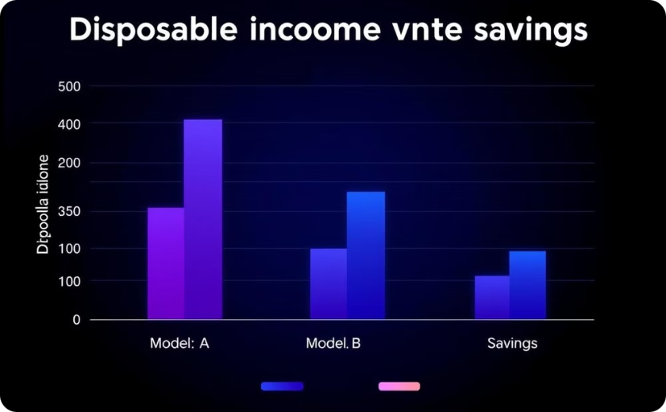
Model Training and Evaluation
Model Performance Metrics
Model Results
RMSE, MAE, and R² score were used to assess model performance for disposable income and potential savings.
The models achieved strong accuracy, demonstrating their ability to predict disposable income and potential savings with a high degree of precision.

Slide 12

Conclusion:
Based on the evaluation of different models, the Random Forest Regressor was selected as the final model for predicting disposable income and potential savings. With its strong accuracy and ability to handle non-linear relationships, the Random Forest model proves to be an effective tool for this task. The results obtained demonstrate its high precision in predicting these financial metrics.

Slide 13

Thank You
We appreciate your time and attention throughout this presentation. The insights we've gained will be invaluable as we continue to refine our data-driven approach to predicting disposable income and savings.

